Slide 1

SQL Project
Paul Titley

Slide 2
AGENDA
The data we have and the answers they give
01
The quality assurance of the data
02
Challenges and future goals
03

Slide 3
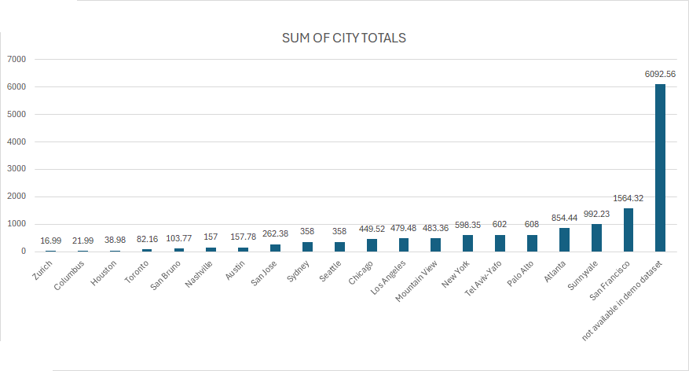
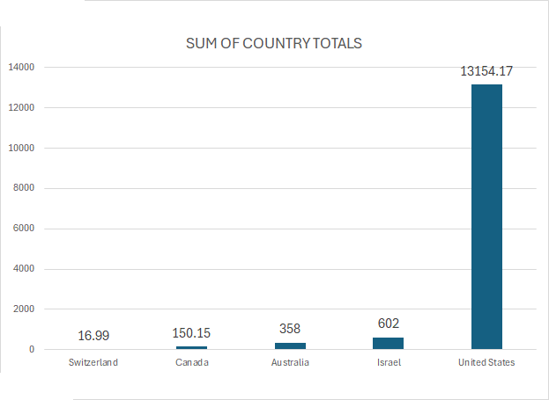
Transaction Revenue Reported

Slide 4
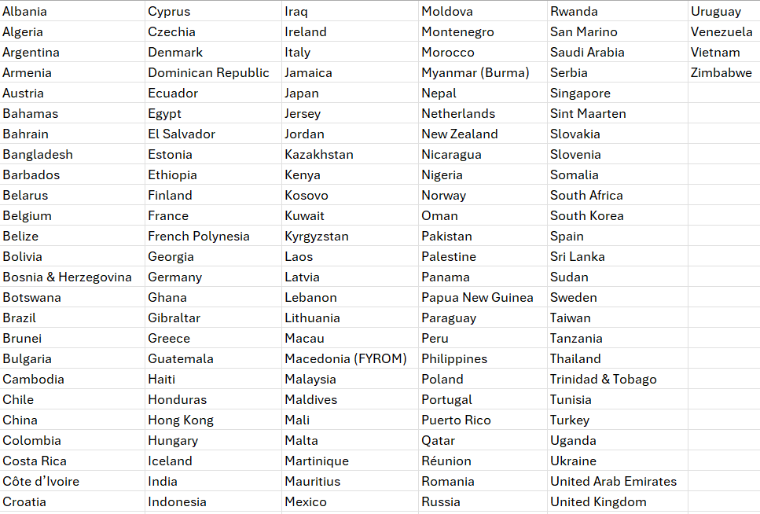
COUNTRIES WITH NO TOTALS REPORTED

Slide 5
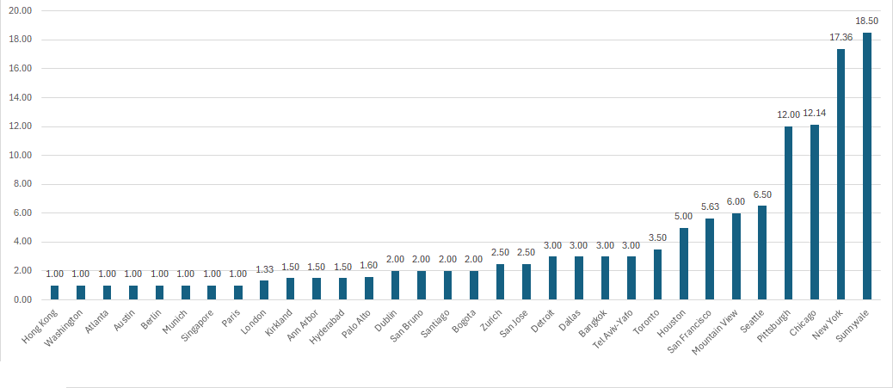
AVERAGE ORDERS BY CITY

Slide 6
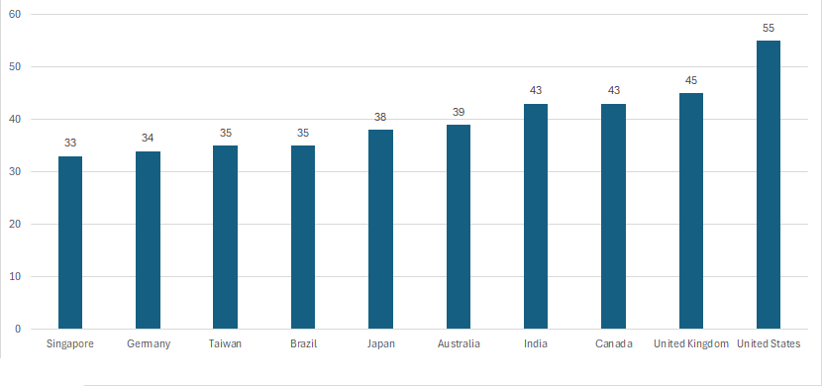
TOP 10 MOST DIVERSE CATEGORIES ORDERED

Slide 7
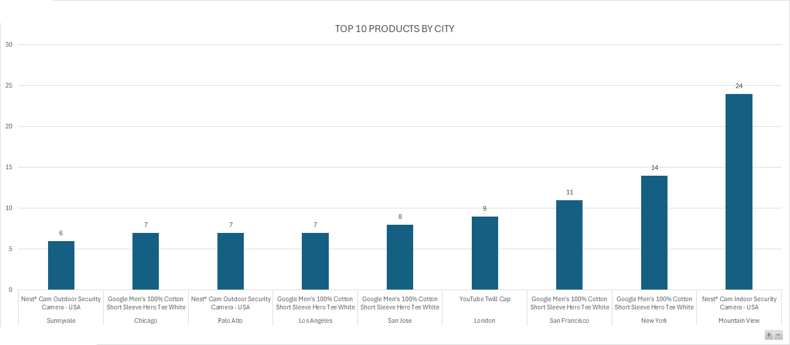
TOP SELLING SKUS BY CITY

Slide 8
What Does The Data Tell Us?
The United States is the leading source of transaction revenue
Orders the most diverse amount of product categories, with the leading number of products sold.
Top players always include Californian based cities

Slide 9

IT’S (probably) GOOGLE!

Slide 10
Challenges:
What’s Available
Quantities
Totals
Problems
Duplicate Data
No Relations
Missing Values
Data is Incomplete
Primary Keys Missing
Inconsistent Relation of Data Between Tables
Duplicate Data
All requires QA to assure that current data available is reliable.

Slide 11
How we QA the Challenges:
Check if missing totals can be figured out
Check if there are duplicate values skewing numbers
Assure that quantity data is consistent among tables
Make sure we are cleaning the data to not leave out unorganized data

Slide 12
What would be my future goals?
Collaboration with others to source missing data
Examine source of data to determine why it’s inconsistent
Attempt to clean data more thoroughly when new insights given

Slide 13
Thank you for your time!
-Paul Titley

